Slide 1

SENTIMENT ANALYSIS OF IMDB MOVIES REVIEW DATASET ZARISH ASIM 2022640 ADINA KAMRAN 2022044

Slide 2

INTRODUCTION:
This code conducts sentiment analysis on movie reviews using deep learning models.
It compares a hybrid model (Bidirectional LSTM + residual network) with a fully connected feedforward neural network (FCNN).
Data preprocessing involves tokenization and padding of text data.
Models are trained and evaluated using various metrics.
Users can input reviews for sentiment prediction.

Slide 3

SCOPE OF PROJECT:
Sentiment Analysis Objective:
Perform sentiment analysis on IMDb movie reviews.
Model Development:
Develop two neural network models:
Hybrid model: Combines Bidirectional LSTM and residual convolutional layers.
Fully connected feedforward neural network (FCNN) model for comparison.
Evaluation Metrics:
Assess model performance using metrics such as accuracy, precision, recall, F1-score, and AUC-ROC.
Confusion Matrix Visualization:
Visualize model performance through confusion matrices.
User Interaction:
Allow users to input movie reviews for sentiment prediction.
Preprocess input and predict sentiment using trained models.
Practical Insights:
Provide insights into classification performance and model comparisons.
Visualization:
Present visualizations of model performance for easy interpretation.

Slide 4

DATASET CHOSEN IMDB REVIEWS DATASET:
Source: The dataset originates from IMDb, a well-known online repository for movies, TV shows, and celebrity-related content.
Content: Comprises 50,000 movie reviews, evenly distributed between positive and negative sentiments (25,000 each).
Format: Presented in CSV format with two columns: 'Review' (textual content) and 'Sentiment' (label denoting positive or negative sentiment).
Usage: Widely utilized for training and assessing ML models, particularly in NLP tasks such as text classification and sentiment analysis. Serves as a standard benchmark for evaluating new algorithms and techniques.

Slide 5

MODEL PERFOMANCE & LIMITATIONS:
Performance: Hybrid model outperforms fully connected feedforward neural network: Higher accuracy, precision, recall, and F1-score. Higher AUC-ROC score, indicating better class discrimination.
Limitations: 1.Computational intensity: Hybrid model requires more resources and longer training times. 2.Overfitting risk: of hybrid model may lead to overfitting, especially on smaller datasets.
Data dependence: Performance of both models may vary with changes in data distribution, affecting generalization to unseen data.

Slide 6

ALGORITHM:
Data Loading and Preprocessing: The IMDb dataset is loaded from a CSV file and processed to handle missing values. Text data is tokenized using the Tokenizer class and padded to ensure uniform length.
Model Architectures: Hybrid Model: Combines a Bidirectional LSTM layer with a residual block.
Fully Connected Feedforward Neural Network Model: Employs a simple architecture with embedding, flattening, and dense layers.
Training and Evaluation: Both models are compiled with appropriate loss functions and optimizers. They are trained on the training data and evaluated using validation and test sets.
Performance metrics: such as accuracy, precision, recall, F1-score, AUC-ROC, and confusion matrix are computed for comparison.
Model Comparison: Performance metrics of the hybrid model are compared against those of the fully connected neural network model. The hybrid model generally outperforms the fully connected model across various metrics.
Visualization: Confusion matrices are plotted to visualize the performance of both models.

Slide 7
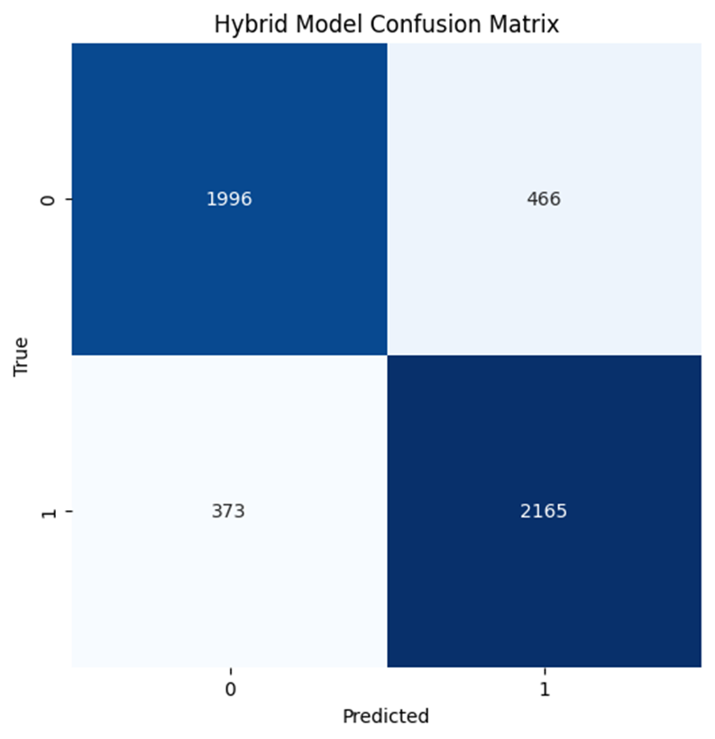
HYBRID MODEL METRICS:
Accuracy: The accuracy of the hybrid model on the test data is approximately 83.22%. This indicates that around 83.22% of the test samples were correctly classified by the model. Precision: The precision of the hybrid model is approximately 82.29%. Recall: The recall of the hybrid model is approximately 85.30%. F1-score: The F1-score of the hybrid model is approximately 83.77%. AUC-ROC: The Area Under the Receiver Operating Characteristic curve (AUC-ROC) of the hybrid model is approximately 91.42%. This metric evaluates the model's ability to distinguish between positive and negative classes. Confusion Matrix: The confusion matrix shows the counts of true positive, true negative, false positive, and false negative predictions made by the hybrid model.

Slide 8
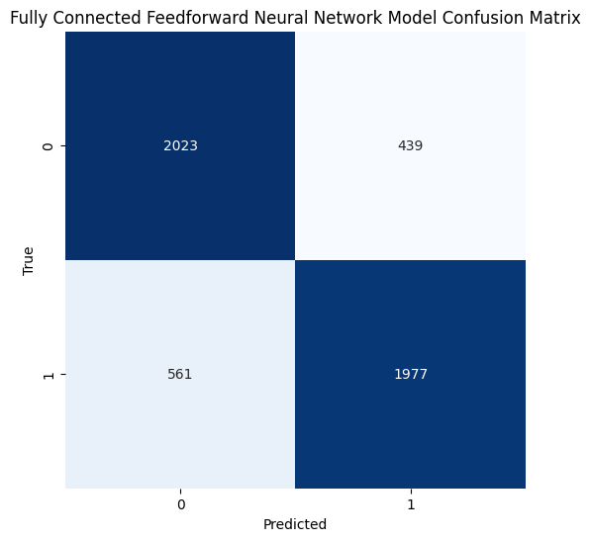
FEEDFORWARD NEURAL NETWORK METRICS:
•Accuracy: The accuracy of the fully connected feedforward neural network model on the test data is approximately 80.00%. •Precision: The precision of the fully connected feedforward neural network model is approximately 81.83%. •Recall: The recall of the fully connected feedforward neural network model is approximately 77.90%. •F1-score: The F1-score of the fully connected feedforward neural network model is approximately 79.81%. •AUC-ROC: The AUC-ROC of the fully connected feedforward neural network model is approximately 87.82%. •Confusion Matrix: The confusion matrix shows the counts of true positive, true negative, false positive, and false negative predictions made by the fully connected feedforward neural network model.

Slide 9
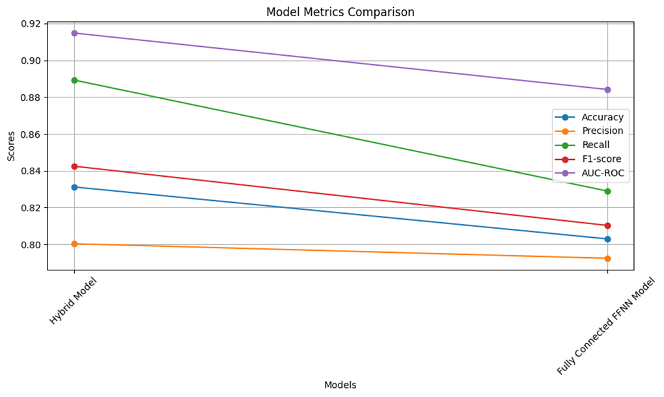
MODEL METRICS COMPARISON:

Slide 10
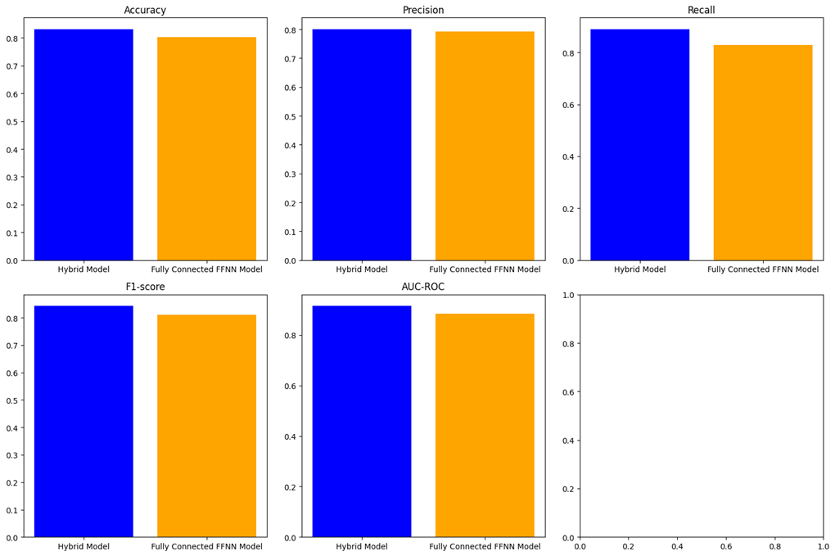
INDIVIDUAL METRICS:

Slide 11
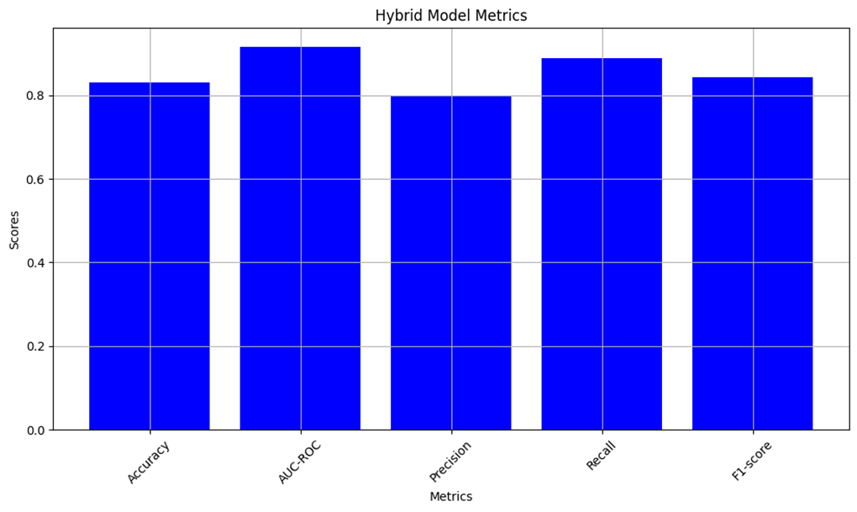
HYBRID MODEL METRICS:

Slide 12
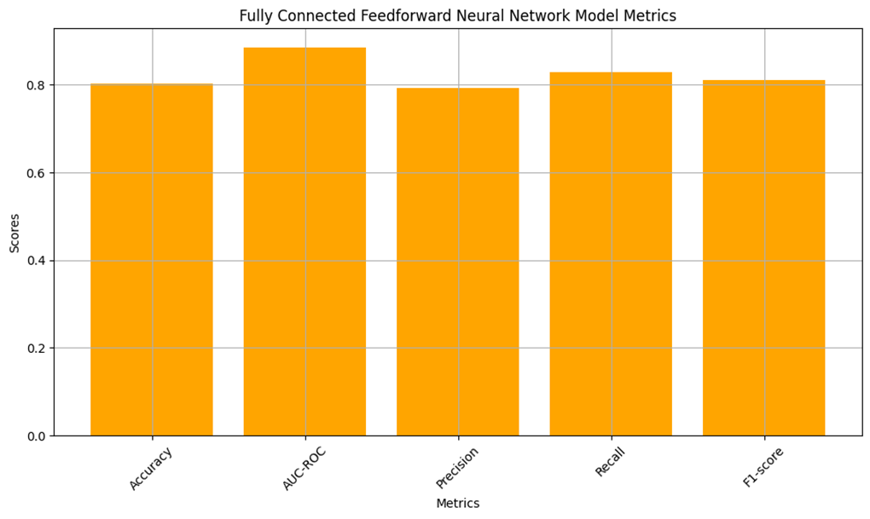
FEEDFORWARD NEURAL NETWORK MODEL METRICS:

Slide 13

POTIENTIAL IMPROVEMENTS:
1. Regularization techniques: Apply dropout or L2 regularization to mitigate overfitting in the hybrid model.
2. Hyperparameter tuning: Utilize grid search or random search to optimize model performance further.
3. Ensemble methods: Explore model averaging or stacking to combine predictions and enhance overall performance.
4. Transfer learning: Utilize pre-trained embeddings or models to leverage knowledge from large-scale datasets or similar tasks.
5. Data augmentation: Employ methods to increase training data diversity, enhancing model robustness.

Slide 14

CONCLUSION:
In summary, the hybrid model combining a bidirectional LSTM and a residual block demonstrated superior performance compared to the fully connected feedforward neural network model in sentiment analysis of movie reviews. Despite its computational complexity, the hybrid model's ability to capture both sequential and hierarchical features led to better accuracy, precision, recall, F1-score, and AUC-ROC score. However, optimization and regularization techniques are needed to address potential overfitting. Overall, this project underscores the effectiveness of hybrid architectures and the importance of thoughtful model selection and evaluation for achieving better performance outcomes in sentiment analysis tasks..

Slide 15

THANK YOU

